Slide 1
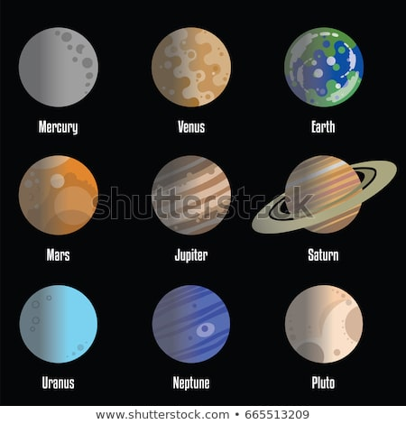
SOLAR SYSTEM

Slide 2
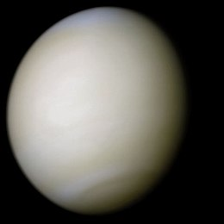
FACTS ABOUT VENUS
Venus is the second planet from the Sun, it rotates in the opposite direction to most other planets.

Slide 3
FACT ABOUT EARTH
Earth is the third planet from the Sun and the only astronomical object in the universe known to harbor life. Earth is 4.5 billion years old.

Slide 4
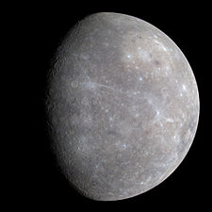
FACT ABOUT MERCURY
Mercury is the smallest and innermost planet in the Solar System. It is named after the Roman deity Mercury, the messenger of the goods.

Slide 5
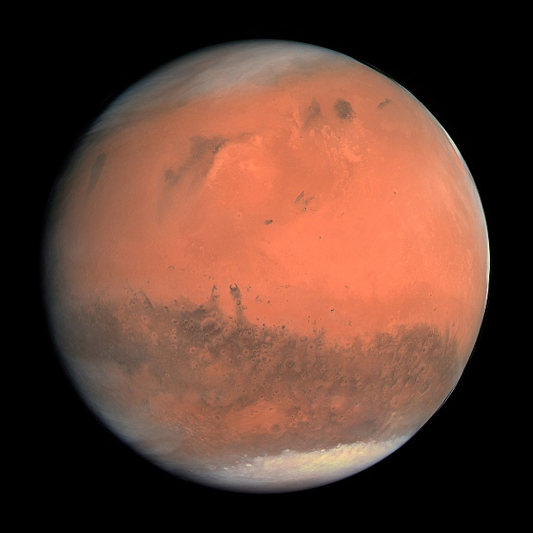
FACT ABOUT MARS
Mars is the fourth planet from the Sun and the second-smallest planet in the Solar System after Mercury. He has name of the Roman god of war, and is often referred to as the "Red Planet„.

Slide 6
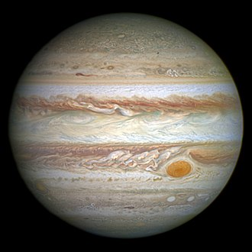
FACT ABOUT JUPITER
Jupiter is the fifth planet from the Sun and the largest in the Solar System. It is a giant planet with a mass one-thousandth that of the Sun.

Slide 7
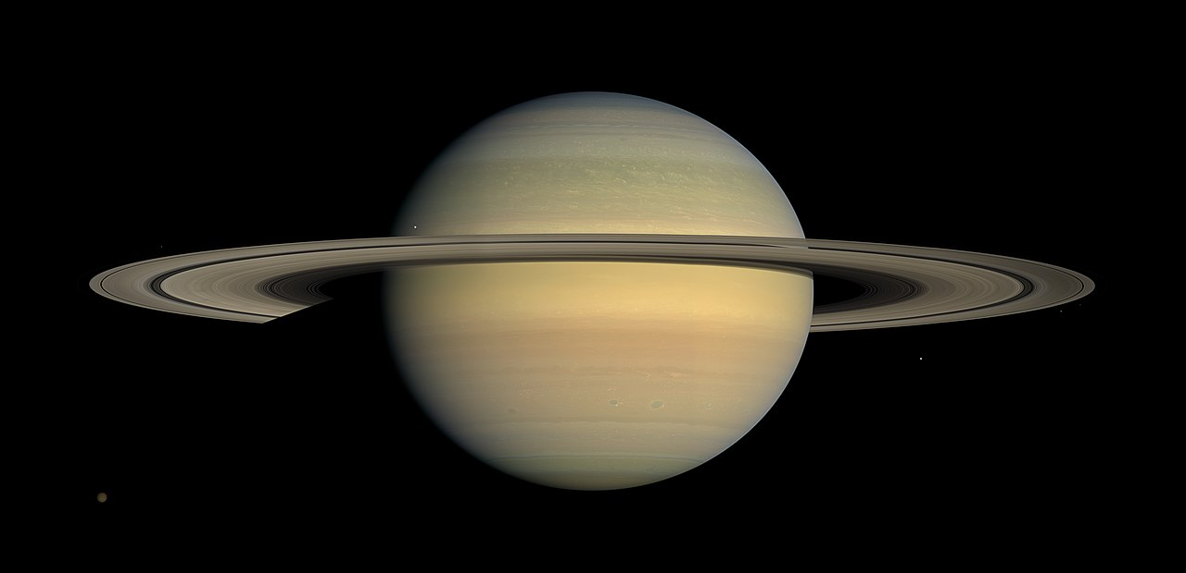
FACT ABOUT SATURN
Saturn is the sixth planet from the Sun and the second-largest in the Solar System, after Jupiter. Saturn is named after the Roman god of agriculture.

Slide 8
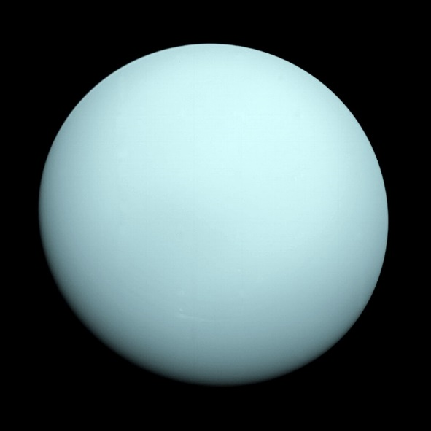
FACT ABOUT URANUS
Uranus is the seventh planet from the Sun. Uranus is similar in composition to Neptune.

Slide 9
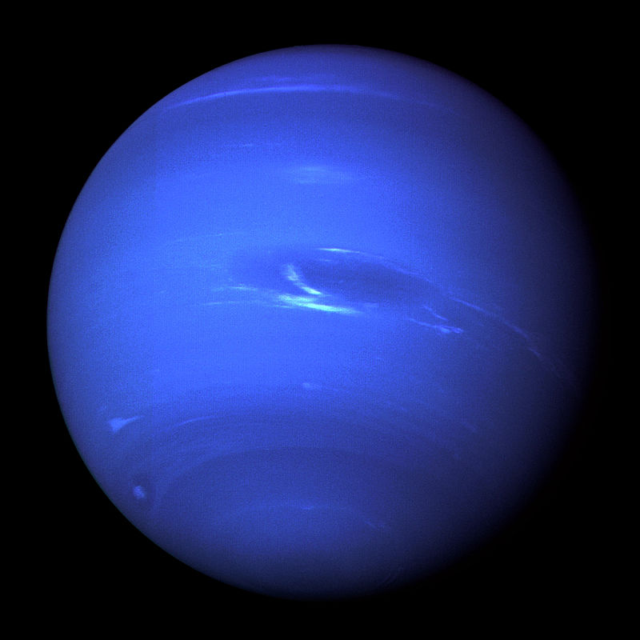
FACT ABOUT NEPTUNE
Neptune is the eighth and farthest known planet from the Sun in the Solar System. In the Solar System, it is the fourth-largest planet.

Slide 10
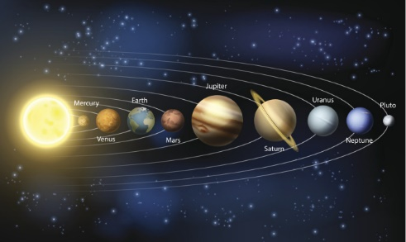
PLANET'S POSITION
Toni J. & Mateo M. 6.c
October, 2018

